Slide 1
“Cat Catching the Rat” Game Project
Zhen Pan(231AHG002)

Slide 2
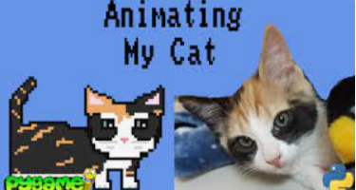
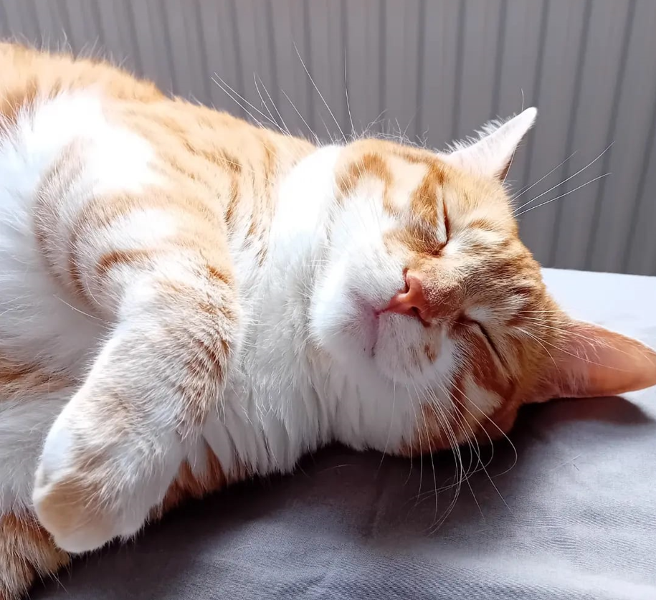

About
Main idea:
Using Pygame and random
libraries in python to create a fun cat game.

Slide 3
Table of contents
01
02
Game Design
Implement Functionalities

Slide 4
01
Game Design
Rules & audio and visual Effects

Slide 5
Win or Lose Rule?
1). 10 turns to decide
2). Cat moves first
3). Cat and Rat moves randomly
4). Rat can not move in the cat’s direction when they are adjacent.

Slide 6
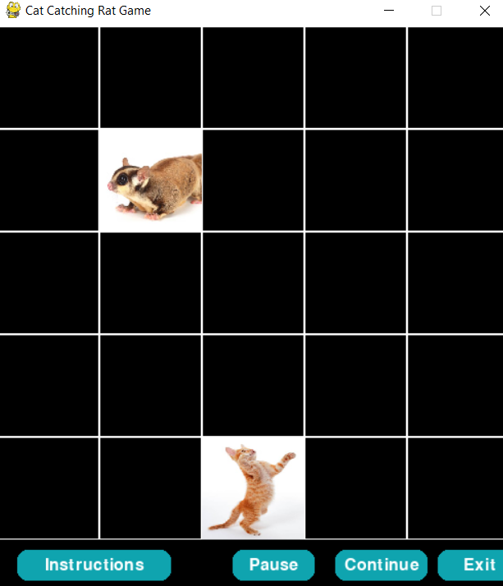
How Many Buttons are needed?
Instructions
Try Again
Exit
Pause
Continue

Slide 7
Sound Effects
● Playing: Super Mario
● Lose: Angry Meowing
● Win: Hampster dance

Slide 8
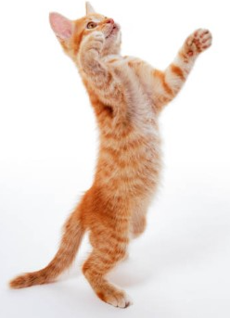
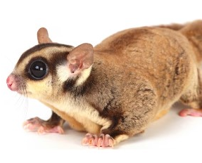
Original Characters
Cat
Rat

Slide 9
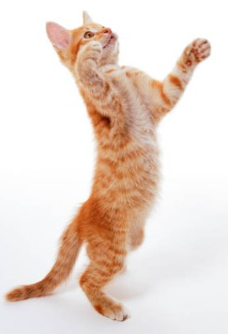
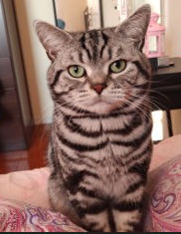
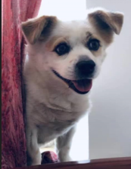
Winner Keyboard Input Options
Option 0 Default
Option 1 Dollar
Option 2 Flower

Slide 10
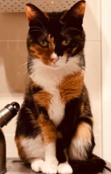
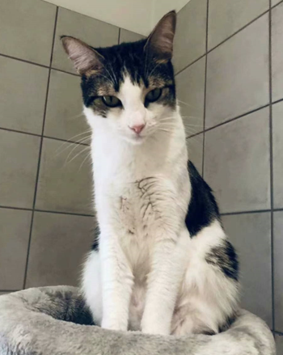
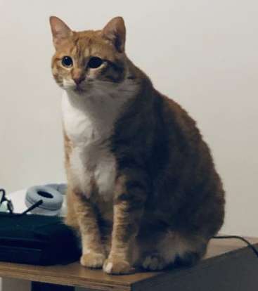
Winner Keyboard Input Options
Option 3 Lucky
Option 4 Niu
Option 5 Sunny

Slide 11

Winner Bonus
Ribbon Popping Up

Slide 12
02
Functionalities

Slide 13
Major Functionalities
Font & Color
Layout
Buttons
Times New Roman
Black & White & Green
5 * 5 grid
Instructions; Pause; Continue; Exit; Try Again
Winner Input Choices
Sound Effects
Winner Bonus
Background; Win; Lose
Select Character 0-5
Ribbon Popping

Slide 14

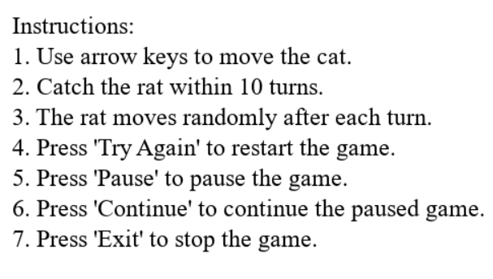

Font & Color

Slide 15
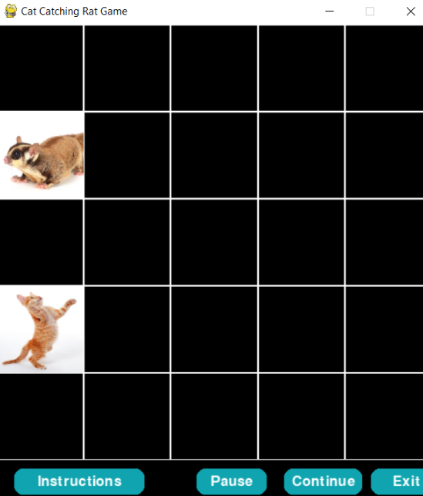
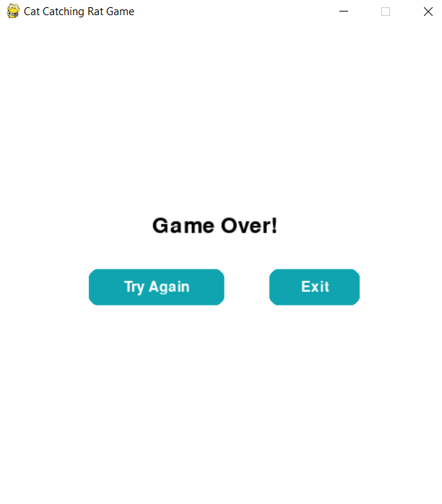
Layout & Buttons

Slide 16
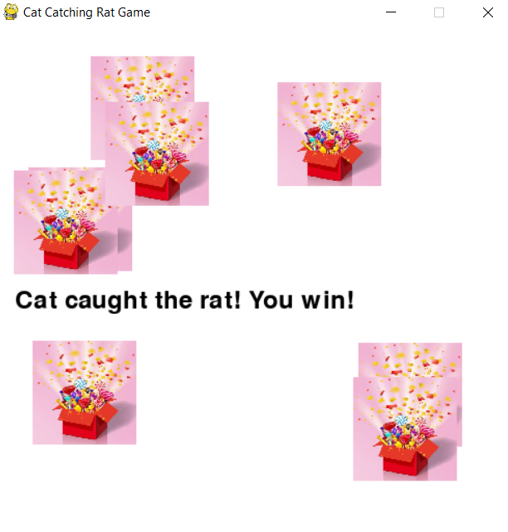
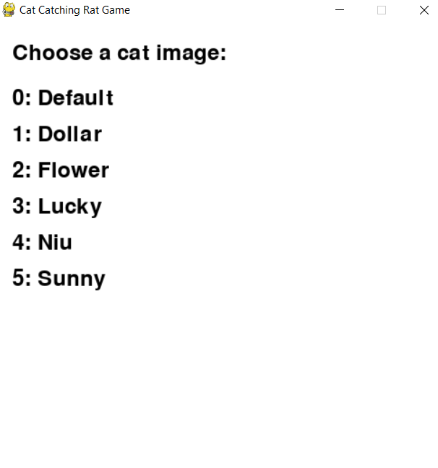
Winner Input & Ribbon Popping

Slide 17
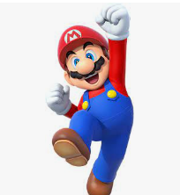
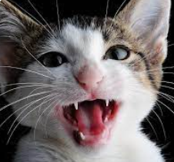

Sound Effects
Win
Lose
Hampster Dance
Angry Meowing

Slide 18
Coding Steps
1
4
2
15
5
13
3
6
Import pygame
Import random
Get audio and image sources
Color and screen display
Pygame.init()
Font settings and images loading and settings
Game settings(grid & cell & turns)
Cat and rat position settings

Slide 19
Coding Steps
07
09
08
10
Define functions
draw_grid; draw_position;
move_position; draw_button; show_instructions; play_background_music; get_user_cat_choice
Define functions
main_game
Call different functions there
Define functions
end_game
Throw_flowers;
draw_end_buttons; handle_mouse_buttons
Pygame.quit()
Call main_game in main.py
Put functions.py/_init_.py in functionPackages folder
Test the game

Slide 20
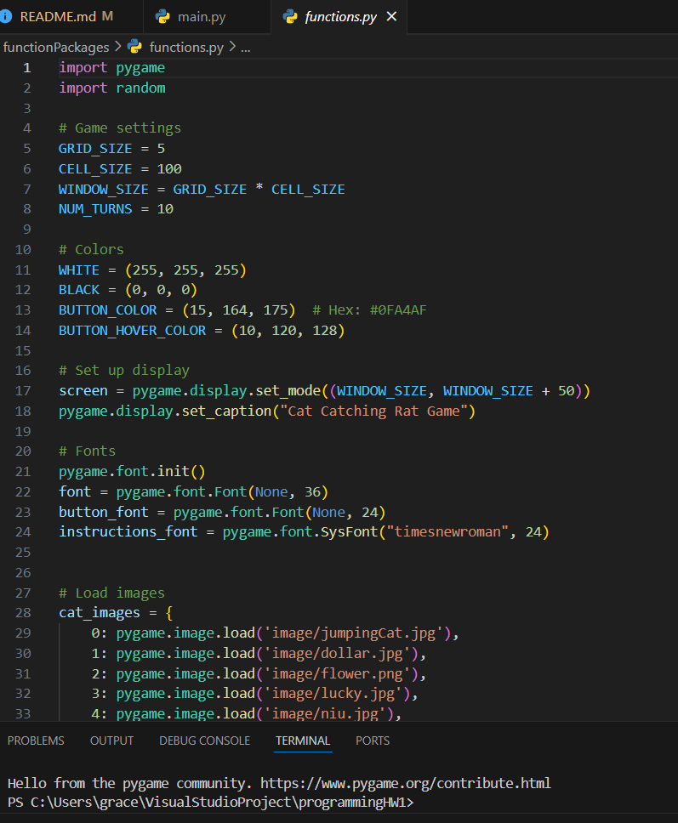
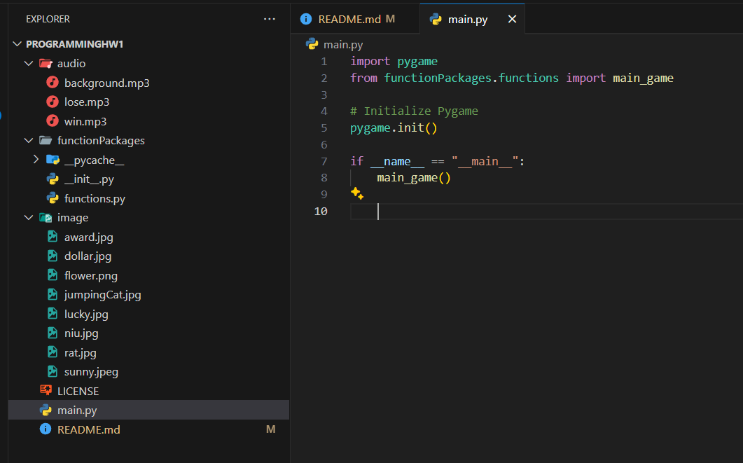
Raw Sources

Slide 21
Code could be cleaner for reusable purposes.
More advanced functionalities could be designed further. (Easy to difficult levels in various steps.)
For learning purposes, it is a user-friendly and entry level game.
Successfully used different loops and functions.
The win-lose rule can be updated.
Conclusions

Slide 22
Thanks!
Do you have any questions?
My Github:
https://github.com/Grace128pan/programmingHW1
Email: Zhen.Pan@edu.rtu.lv
gracepan922@gmail.com

